Slide 1

Capstone Project
Theft Alert: Developing an Intelligent Detection System for Supermarket Security.
TEAM : MISSION POSSIBLE

Slide 2
Table of contents
01
02
03
04
05
06
Project Description
TEAM
Objectives
Team Information and Responsibilities
What is achieved by the project
Causality for project
Persona
Tools and Usage
Retrospective
Who can this product cater to(examples) ?
Tools used with brief overview
Describes scheduling and Team Management

Slide 3
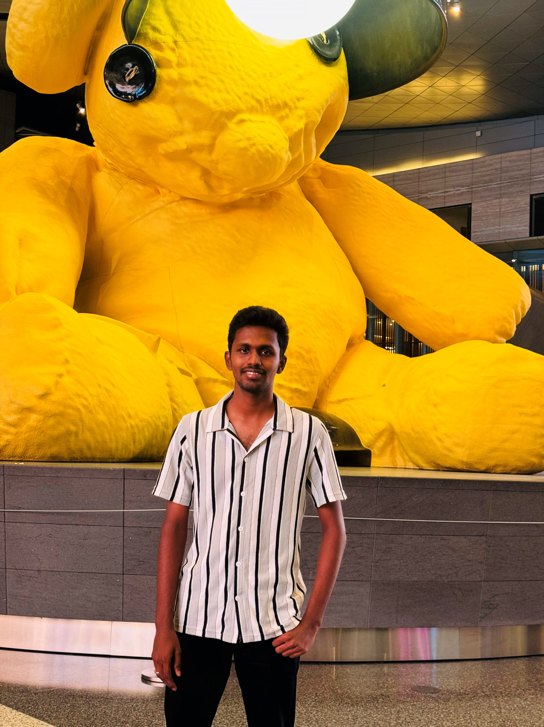
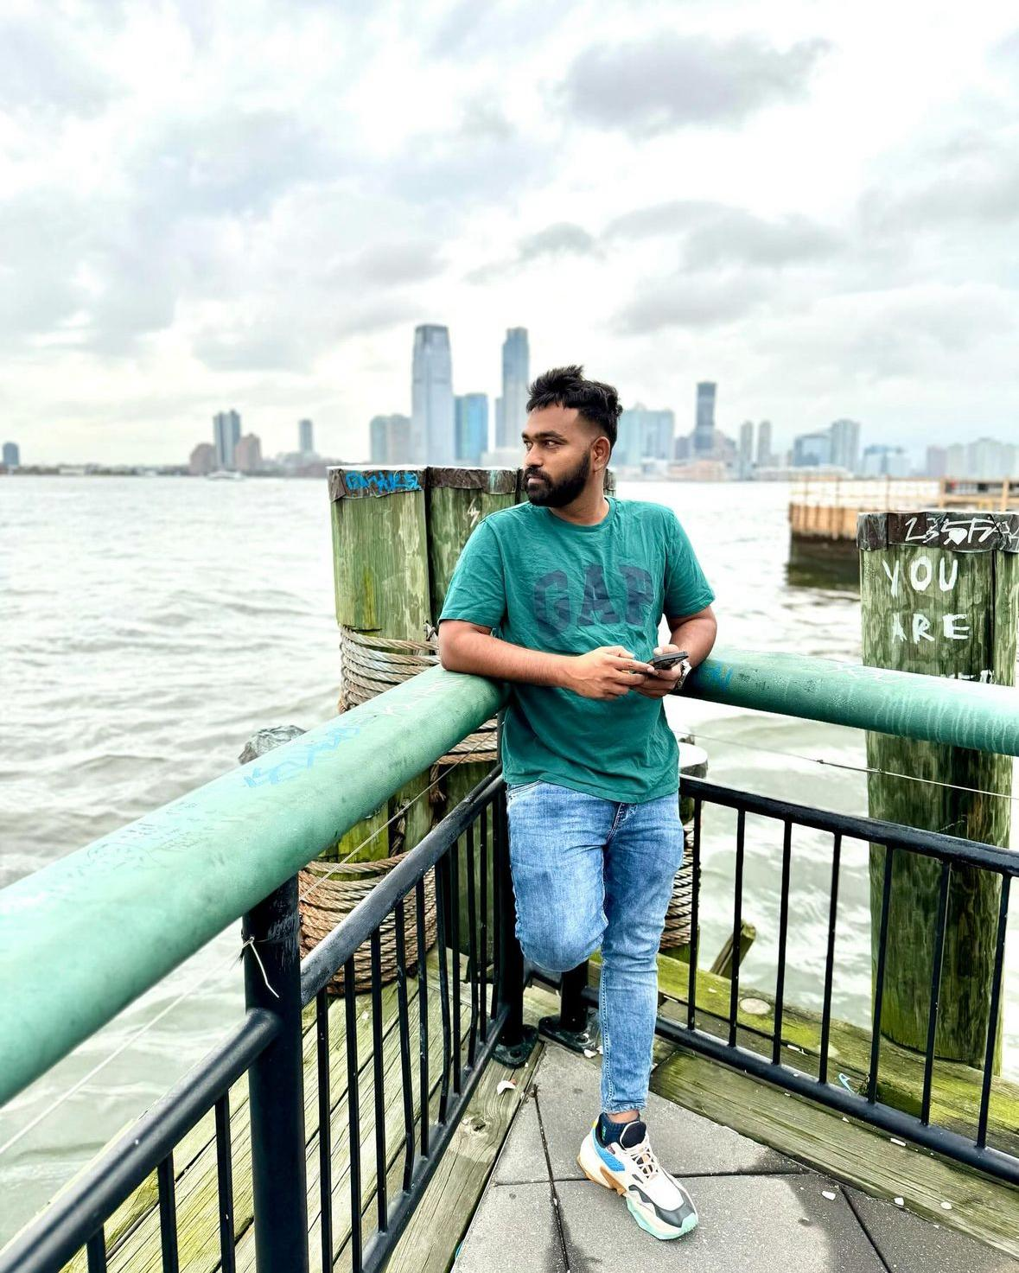
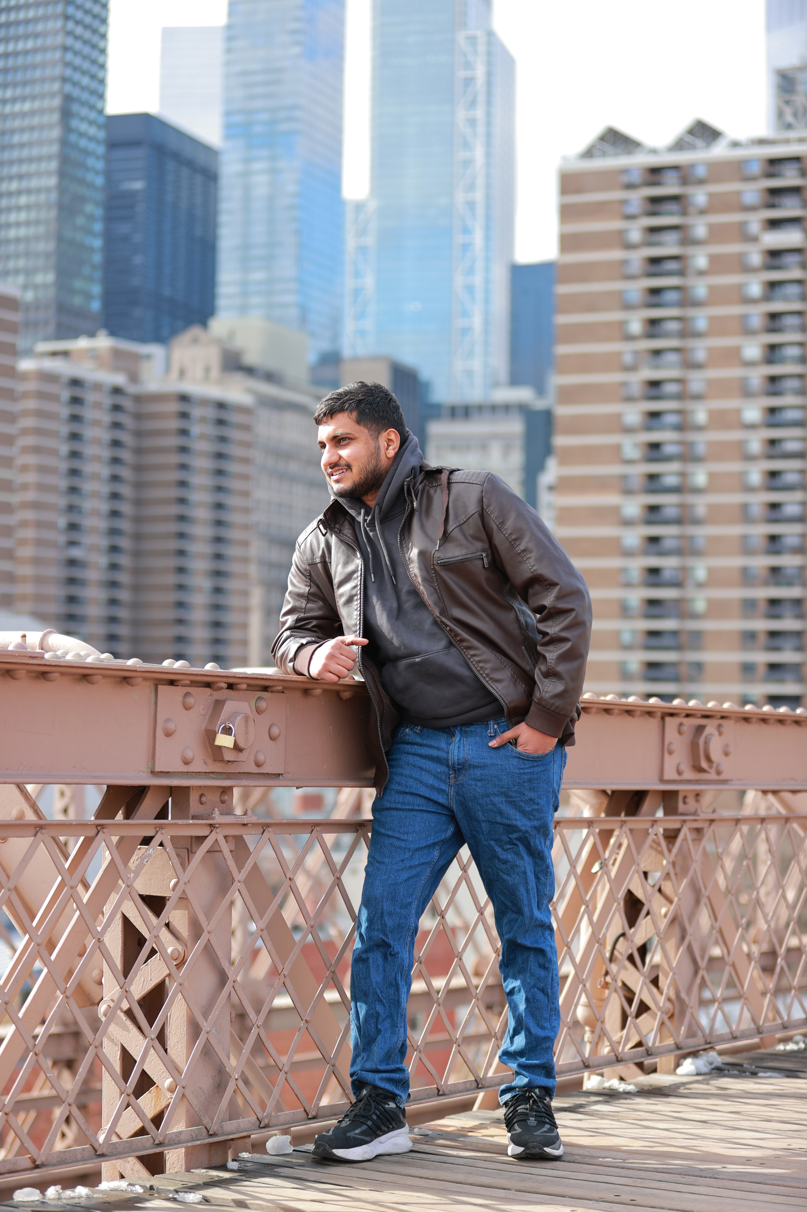
TEAM
Shiva
Data Scientist
Prudhvi
Full Stack developer
Vinod
Data Analyst & Product Developer

Slide 4
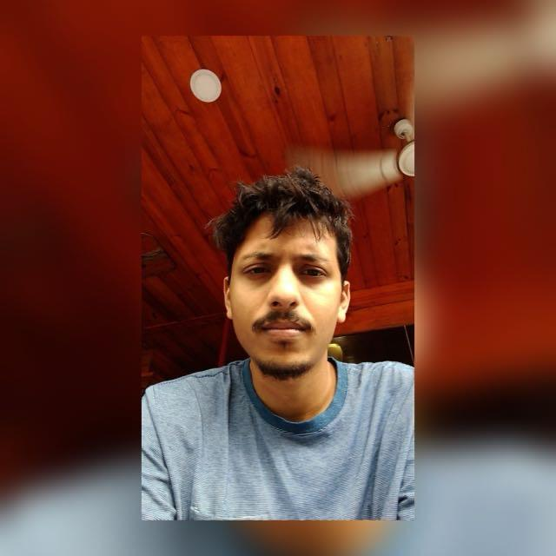
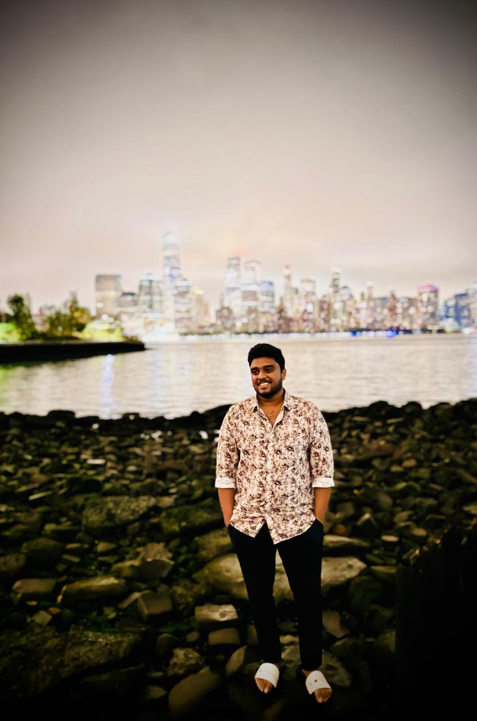
Mayank
Artificial Intelligence Engineer & Project Manager
Vishnu Raju
Software Developer

Slide 5
Project Description
The Supermarket Theft Detection System is a cutting-edge solution that utilizes advanced computer vision and machine learning algorithms to monitor and analyze customer behavior, identifying potential theft incidents in real-time. The system integrates with existing CCTV cameras for real-time video monitoring, detects objects being removed from shelves, and uses facial recognition to identify repeat offenders. It sends real-time alerts to security personnel via mobile app or email, enabling prompt response to potential theft incidents. Additionally, the system provides detailed analytics on theft incidents, allowing supermarket managers to identify patterns and trends, and make data-driven decisions to improve security protocols.

Slide 6
Objectives
This project has countless applications, each for its unique use, ranging from maintaining vigilance during activites to tagging vehicles on tolls. Our model mainly abbreviates on maintaining vigilance in supermarkets due to limitations in knowledge and experience. We look to achieve the following objectives –
To minimize/eradicate store theft
To maximize profitability of store
To increase safety of store personnel by early detection and warnings
To make shopping seamless and convenient for customers
To reduce operational costs

Slide 7
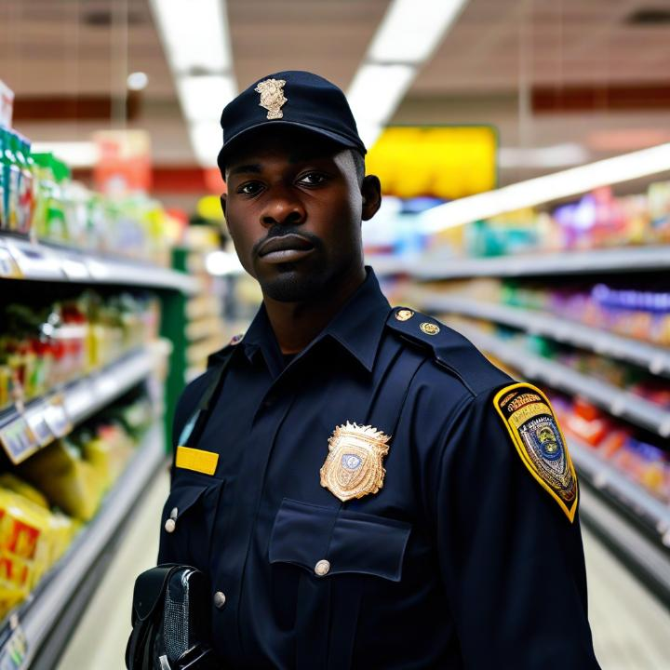
PERSONA - UNO
Meet officer James, a seasoned security personnel in his late 30s, responsible for ensuring the safety and security of a large retail complex. With years of experience, he understands the importance of being proactive and responsive to potential threats. However, with the vast area to cover and limited resources, it's a daunting task to keep a watchful eye on every corner of the market.
Our surveillance system software is designed to empower Officer James with advanced tools to enhance his security operations. With features such as real-time video monitoring, facial recognition, and alerts, he can quickly identify and respond to suspicious activity, track individuals, and prevent potential threats. The software also allows him to review footage, generate reports, and collaborate with other security personnel, making it easier to investigate incidents and improve overall security protocols. This enables officer James to provide a safer and more secure environment for customers and employees.

Slide 8
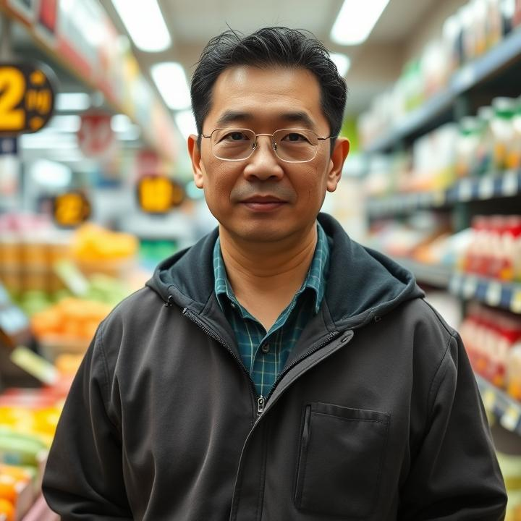
PERSONA - DOS
Meet Mr. Wong, a diligent shop owner in his mid-40s, who runs a bustling convenience store in a busy neighborhood. With a keen eye for detail, he takes pride in ensuring the safety and security of his customers, employees, and merchandise. However, with the increasing number of customers and transactions, it's becoming challenging for him to keep a watchful eye on everything.
That's where our surveillance system software comes in. Our software is designed to provide Mr. Wong with a comprehensive and user-friendly solution to monitor his store's activities in real-time. With features such as live video feed, motion detection, and alerts, he can keep a close eye on his store from anywhere, at any time. This will enable him to respond promptly to any suspicious activity, prevent theft, and ensure a safe shopping environment for his customers.

Slide 9

PERSONA - TRES
Meet Ms. Rodriguez, a busy supermarket manager in her early 40s, responsible for overseeing the daily operations of a large grocery store. With a keen focus on customer satisfaction and operational efficiency, she strives to ensure a seamless shopping experience for her customers. However, with the constant flow of customers and employees, it's challenging to monitor every aspect of the store.
Our surveillance system software is designed to support Ms. Rodriguez in optimizing her store's operations and enhancing customer experience. With features such as people counting, heat mapping, and dwell time analysis, she can gain valuable insights into customer behavior, identify bottlenecks, and optimize store layouts. The software also enables her to monitor employee activity, track inventory, and receive alerts on potential security threats, allowing her to respond promptly and make data-driven decisions to improve overall store performance and customer satisfaction.

Slide 10













Tools
Frontend
Backend
Database
IDE & Additional Tools
Communication

Slide 11
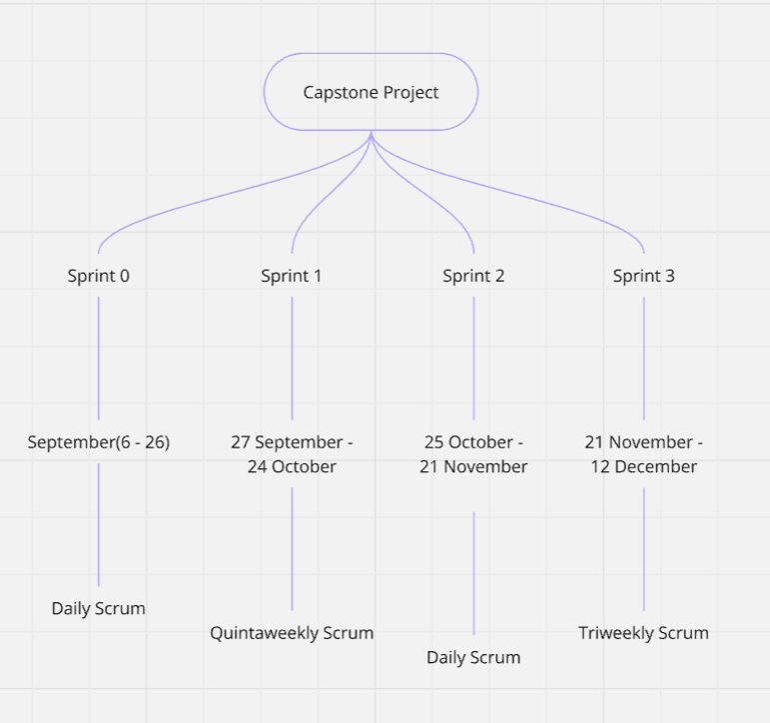
Schedule

Slide 12
Team Agreement
Following were discussed and put into mutual agreement amongst peers with no exceptions to be made –
We will communicate regularly via our designated platform (i.e Whatsapp, Google meet) and have weekly check-ins to discuss progress and any challenges.
Each team member will have defined roles based on strengths and interests (i.e. coding, documentation, testing), which will be agreed upon at the start of the project.
We will set clear deadlines for each project phase and milestone. All members agree to adhere to these timelines to ensure project progress.
We will adhere to coding standards and best practices (e.g., comments, formatting) to ensure code is maintainable and understandable by all team members.
Each team member is responsible for their tasks and must communicate any issues or delays as soon as possible to the group.
In case of disagreements, we will address conflicts openly and respectfully, seeking to find a solution that works for everyone.
We will collaboratively prepare a final presentation and ensure that all project documentation is complete and accessible.

Slide 13
Retrospective
What went well ? | What needs to be improved ? | What will we do next time ?
Effective Communication | Time Management | We will streamline our ideas more effectively and efficiently for better usage of time.
Role Clarity | Conflict Resolution | We will resort to, whole team mediating the situation rather than just the leader doing so.
Supportive Environment | Documentation | Instead of assigning a single person for the job, we will ask random members to volunteer if and when needed.

Slide 14
Thanks!
Do you have any questions?

